Slide 1
Introduction:
Train keeps people moving, but delays cause problem which have a significant impact on operational efficiency, customer satisfaction, and financial performance.
This project analyzes train delay data to identify patterns, costs, and areas for improvement to satisfy customers using Power BI.
Goal: To provide insight for decision making.

Slide 2
Problem Statement
The Problem:
Trains are often delayed.
We don’t know exactly how much time is wasted.
We don’t know exactly how much money those delays cost.
Raw data is messy, so managers can’t easily see the big picture.
Why it matters:
Without clear data, it’s hard to focus resources.
Managers need to know:
How much time is lost?
Which trains or reasons cause the most delays?
How much money is lost?
Operator_code that that delay most.

Slide 3
Selected KPI
KPI 1: Total Delay Minutes Reason: Helps measure operational efficiency and time lost.
KPI 2: Total Delay Cost Reason: Provides financial impact of delays and cost per incident.
KPI Definitions
Total Delay Minutes = Sum of all minutes trains were delayed.
Avg Delay per Incident = Delay minutes ÷ number of incidents.
Total Delay Cost = Monetary value of delays (sum of cost per incident).
Avg Cost per Incident = Total Delay Cost ÷ number of incidents.

Slide 4
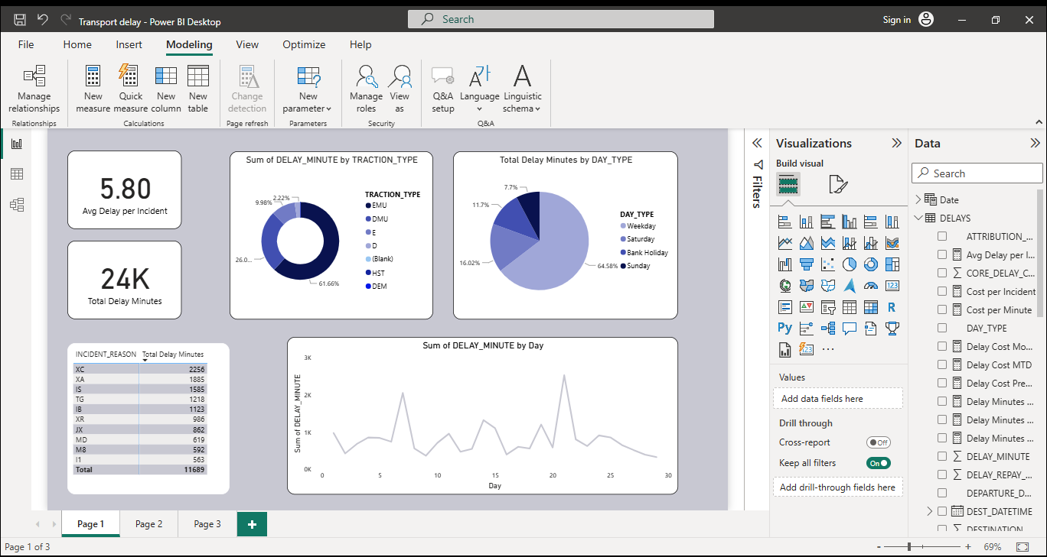
Delay minutes
KPI cards (avg delay per incident, total minutes).
Donut chart (delay minutes by traction type).
Pie chart (delay minutes by day type).
Line chart (delay trend by day).
Slicer (day type by transaction type).
Table (incident reason vs delay minutes).
Key findings (short bullets)
Weekdays have highest delays.
Sunday have the lowest delays
EMU trains contribute the most.
D trains contribute the lowest
Specific incident codes dominate
Avg Dealy per incident = 6 mins
Total Delay minute =24,000
EMU trains = 60%+ of delays
Weekdays = highest delays

Slide 5
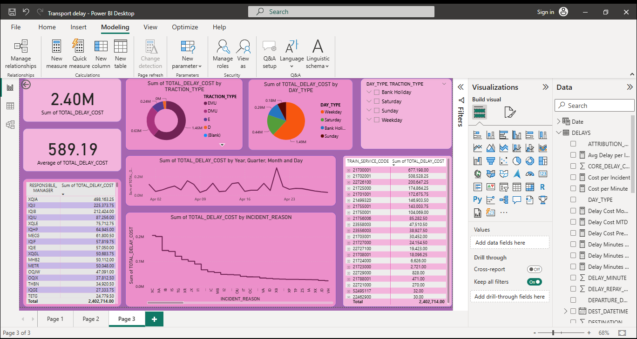
Delay Cost
KPI cards (total cost, avg cost per incident).
Donut chart (delay cost by traction type).
Pie chart (cost by day type).
Line chart (cost trend over time).
Table (incident reason vs total cost).
Table (service code vs total cost).
Key finding:
Costs are concentrated in fewer incidents.
Weekdays dominate cost distribution.
Certain operators code/service codes drive high costs (21700001/541528MW).

Slide 6
Recommendations
Target EMU Trains for Maintenance
Since EMUs cause most delays, schedule preventive maintenance and audits.
Focus on the filtered top 10 Incident Reasons on the dashboard
Use a root-cause analysis (like 10 Whys) to reduce the few reasons that cause most of the cost.
Reallocate Resources to Weekdays
Increase staff and backup trains during weekdays when delays are highest.
Use Predictive Analytics
Apply forecasting models to spot delay patterns early.
Improve Communication Systems
Real-time alerts for operators when issues occur, it gives quicker response.
Train Crew Efficiency
Offer targeted training for staff linked to the most frequent delay reasons.
Collaborate Across Departments
Share dashboards with both operations and finance teams to align technical fixes with budget impact.
Benchmark and Monitor Regularly
Compare monthly delay KPIs to track progress.
Set targets (e.g., reduce average delay per incident by 15% in the next quarter).
Passenger-Focused Initiatives
Communicate delays transparently via apps/boards.
Reduce negative customer impact while internal fixes are ongoing.
Policy & Strategy Review
Reassess scheduling and contingency plans for high-risk trains/routes.

Slide 7
References
Dataset: Delay Records (class dataset)
Tools: Power BI, and Excel.
Microsoft Power BI Documentation
Transport industry reports

